Slide 1
Ray Tracer
ZHANG Kai
10/02/2020

Slide 2
CONTENTS
Structure
Functions
Test Result
Future plan

Slide 3
Structure
/01

Slide 4
Structure
MovingSphere
Overlap
Camera
checkertexture
BVHNode
Hitable
Texture
HitableList
vec3
ray
constanttexture
Sphere
Material
dielectric
lambertian
metal
Notes:
Base class
Derived class
inheritance

Slide 5
Structure
Basic class:
Basic structure and arithmetic
Linear ray: P=A+t*B
vec3
ray
MovingSphere
Class about hit:
Object class
Hit detection class
Hit area class
BVHNode
Hitable
HitableList
Sphere

Slide 6
Structure
Material
Material class:
Dielectric material
Lambertian material
Metal material
dielectric
lambertian
metal
checkertexture
Texture class:
2D color texture
3D texture
Texture
Constant
texture

Slide 7
Structure
Camera
Overlap
Camera class:
Camera position
Orientation
Focus
Aperture
Overlap class:
Surrounding box of objects

Slide 8
Functions
/02

Slide 9
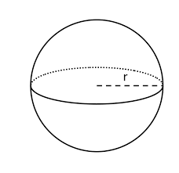
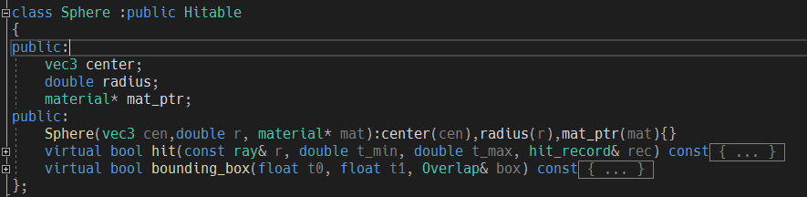
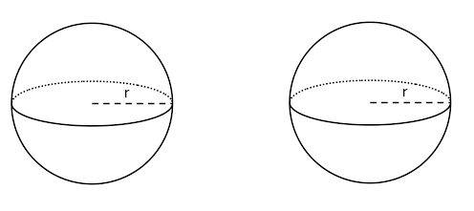
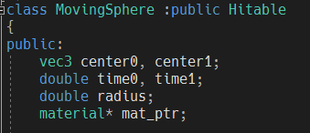
Adding objects
mat_prt
Sphere
center
radius
Moving
Sphere
center0, time0
center1, time1

Slide 10
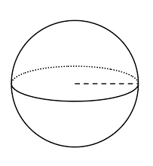
Hit record
ray
Hitable
Not intersection
tangent
intersection

Slide 11

antialiasing
The center pixel’s value is the average number of its surrounding pixels’ value

Slide 12
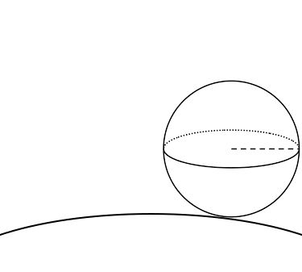
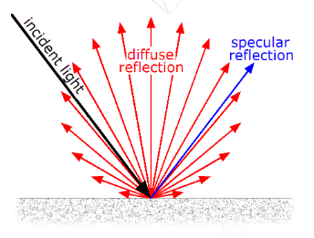
Diffuse material
Build random reflecting ray:
Light attenuation: Multiply a value 0.5 (light bouncing rate) to the color to simulate the absorption of the light (light attenuation) when it bounces around diffuse materials.
ray
Notes:
orthogonal

Slide 13
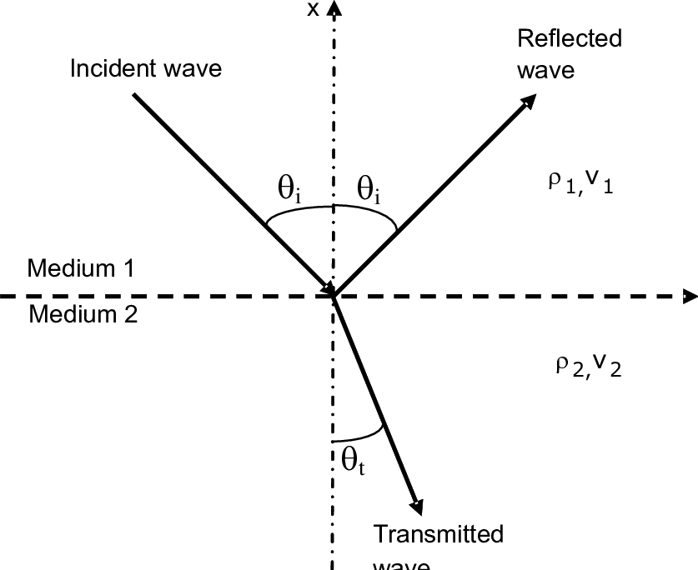
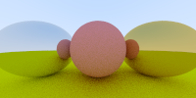
Reflect and refract

Slide 14
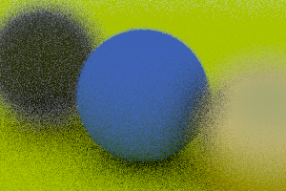
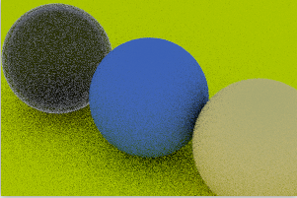

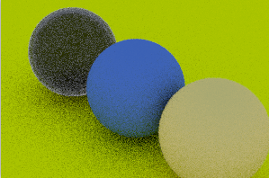
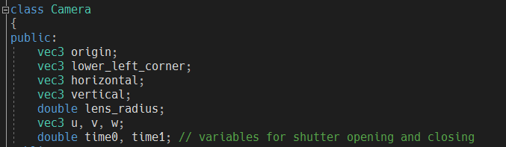
Positional camera
Look from
Look at
Aperture=2.0
Pos=(2,2,2)
Aperture=0.1
Pos=( 2,3,2)
Aperture=0.1
Pos=( 3,3,2)

Slide 15
Speed up methods
openMP accelerate the calculation by parallel computing. (multi-threads)
Bounding box methods to reduce the computation cost
Case 1
Case 2
T0(s)
T1(s)
T(s)<(T0+T1)(s)
(T0+T1)(s)

Slide 16
Test results
/03

Slide 17
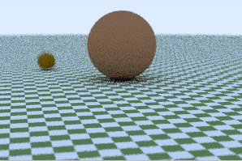
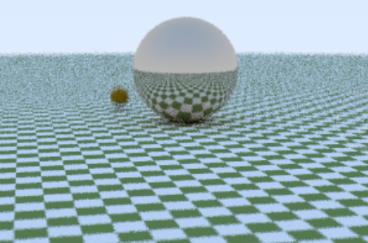
Sphere and moving sphere

Slide 18
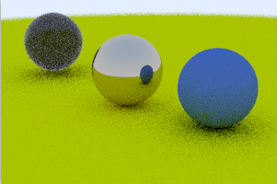
material
Notes:
Dielectric
Lambertian
metal

Slide 19
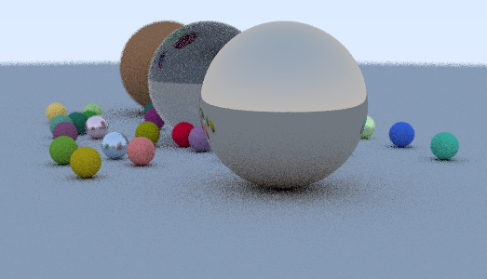
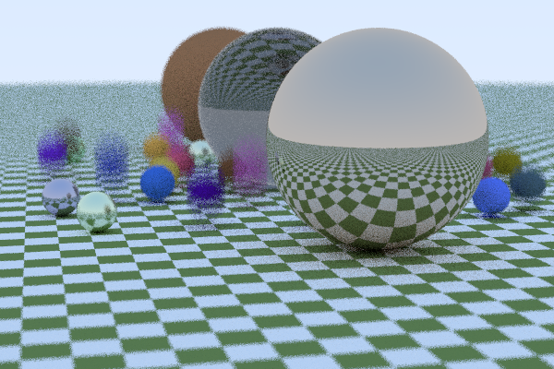
final
Size:600*400
Time:183s(without OPENMP)
100s(with OPENMP)

Slide 20
Future plan
/04

Slide 21
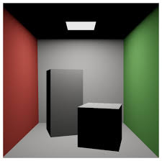
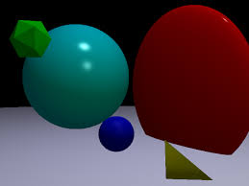
More types of objects
Notes:
Cylinder
polyhrdron

Slide 22
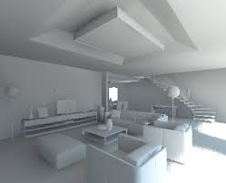
interaction
Rotation
Translation

Slide 23
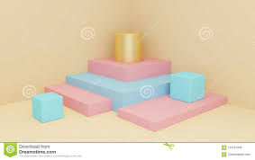
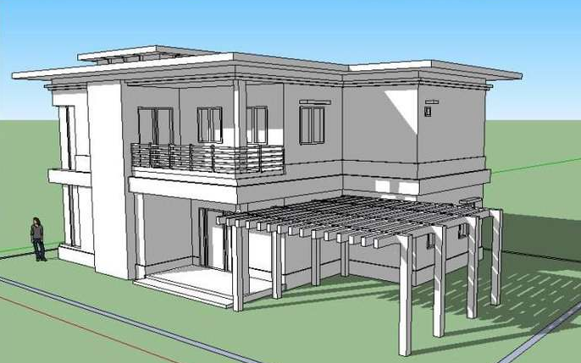
more
Acceleration: openGL, cuda,…
More complicated objects
More types of textures and materials

Slide 24
Thank you

